Slide 1
System Sequence Diagrams (SSD)

Slide 2
Contents
Use Case description
Making SSD from Use case description
Identifying objects and operations
SSD notation
Examples

Slide 3
Creating SSD
How to construct an SSD from a use case:
Actors
Identify Nouns: Objects
Identify verbs: Interaction between Objects

Slide 4
Example
The SafeHome security function enables the homeowner to configure the security system when it is installed, monitors all sensors connected to the security system, and interacts with the homeowner through the Internet, a PC, or a control panel.
During installation, the SafeHome PC is used to program and configure the system. Each sensor is assigned a number and type, a master password is programmed for arming and disarming the system, and telephone number(s) are input for dialing when a sensor event occurs.
When a sensor event is recognized, the software invokes an audible alarm attached to the system. After a delay time that is specified by the homeowner during system configuration activities, the software dials a telephone number of a monitoring service, provides information about the location, reporting the nature of the event that has been detected. The telephone number will be redialed every 20 seconds until a telephone connection is obtained.
The homeowner receives security information via a control panel, the PC, or a browser, collectively called an interface. The interface displays prompting messages and system status information on the control panel, the PC, or the browser window. Homeowner interaction takes the following form…

Slide 5
Identifying objects
The SafeHome security function enables the homeowner to configure the security system when it is installed, monitors all sensors connected to the security system, and interacts with the homeowner through the Internet, a PC, or a control panel.
During installation, the SafeHome PC is used to program and configure the system. Each sensor is assigned a number and type, a master password is programmed for arming and disarming the system, and telephone number(s) are input for dialing when a sensor event occurs.
When a sensor event is recognized, the software invokes an audible alarm attached to the system. After a delay time that is specified by the homeowner during system configuration activities, the software dials a telephone number of a monitoring service, provides information about the location, reporting the nature of the event that has been detected. The telephone number will be redialed every 20 seconds until a telephone connection is obtained.
The homeowner receives security information via a control panel, the PC, or a browser, collectively called an interface. The interface displays prompting messages and system status information on the control panel, the PC, or the browser window. Homeowner interaction takes the following form…

Slide 6
Identifying operations
The SafeHome security function enables the homeowner to configure the security system when it is installed, monitors all sensors connected to the security system, and interacts with the homeowner through the Internet, a PC, or a control panel.
During installation, the SafeHome PC is used to program and configure the system. Each sensor is assigned a number and type, a master password is programmed for arming and disarming the system, and telephone number(s) are input for dialing when a sensor event occurs.
When a sensor event is recognized, the software invokes an audible alarm attached to the system. After a delay time that is specified by the homeowner during system configuration activities, the software dials a telephone number of a monitoring service, provides information about the location, reporting the nature of the event that has been detected. The telephone number will be redialed every 20 seconds until a telephone connection is obtained.
The homeowner receives security information via a control panel, the PC, or a browser, collectively called an interface. The interface displays prompting messages and system status information on the control panel, the PC, or the browser window. Homeowner interaction takes the following form…

Slide 7
A First Look at Sequence Diagrams
Illustrates how objects interacts with each other.
Emphasizes time ordering of messages.
Can model simple sequential flow, branching, iteration, recursion and concurrency.

Slide 8
A Sequence Diagram
member: LibraryMember
book:Book
:Book Copy
borrow(book)
ok = mayBorrow()
[ok] borrow(member)
setTaken(member)

Slide 9
A Sequence Diagram
X-Axis (objects)
member: LibraryMember
book:Book
:Book Copy
borrow(book)
Object
Life Line
Y-Axis (time)
ok = mayBorrow()
message
Activation box
[ok] borrow(member)
setTaken(member)
condition

Slide 10
Object
Object naming:
syntax: [instanceName][:className]
Name classes consistently with your class diagram (same classes).
Include instance names when objects are referred to in messages or when several objects of the same type exist in the diagram.
The Life-Line represents the object’s life during the interaction
myBirthdy :Date

Slide 11
Messages
An interaction between two objects is performed as a message sent from one object to another (simple operation call, Signaling, RPC)

Slide 12
Messages (Cont.)
A message is represented by an arrow between the life lines of two objects.
Self calls are also allowed
The time required by the receiver object to process the message is denoted by an activation-box.
A message is labeled at minimum with the message name.
Arguments and control information (conditions, iteration) may be included.

Slide 13
Return Values
Optionally indicated using a dashed arrow with a label indicating the return value.
Don’t model a return value when it is obvious what is being returned, e.g. getTotal()
Model a return value only when you need to refer to it elsewhere, e.g. as a parameter passed in another message.
Prefer modeling return values as part of a method invocation, e.g. ok = isValid()

Slide 14
Synchronous Messages
Nested flow of control, typically implemented as an operation call.
The routine that handles the message is completed before the caller resumes execution.
:A
:B
doYouUnderstand()
return (optional)
Caller Blocked
yes

Slide 15
Object Creation
An object may create another object via a <<create>> message.
Preferred
:A
:B
:A
<<create>>
<<create>>
:B
Constructor

Slide 16
Object Destruction
An object may destroy another object via a <<destroy>> message.
An object may destroy itself.
Avoid modeling object destruction unless memory management is critical.
:A
:B
<<destroy>>

Slide 17
Control information
Condition
syntax: ‘[‘ expression ’]’ message-label
The message is sent only if the condition is true
example:
Iteration
syntax: * [ ‘[‘ expression ‘]’ ] message-label
The message is sent many times to possibly multiple receiver objects.
[ok] borrow(member)

Slide 18
Control Information (Cont.)
Iteration examples:
:CompoundShape
:Shape
:Driver
:Bus
draw()
*draw()
*[until full] insert()
The syntax of expressions is not a standard

Slide 19
Control Information (Cont.)
The control mechanisms of sequence diagrams suffice only for modeling simple alternatives.
Consider drawing several diagrams for modeling complex scenarios.
Don’t use sequence diagrams for detailed modeling of algorithms (this is better done using activity diagrams, pseudo-code or state-charts).

Slide 20
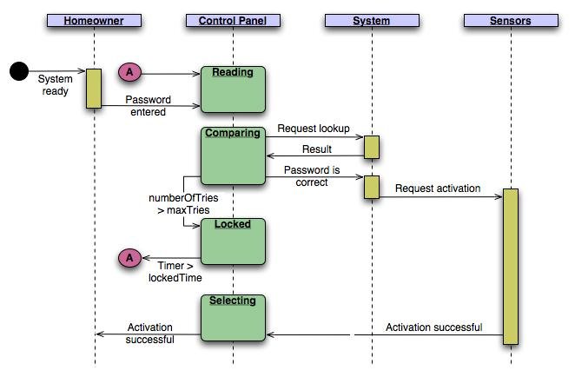

Slide 21
Example 1
:Violations Dialog
:Violations Controller
:Violations DBProxy
Lookup Traffic Violation
Clerk
lookup
viewButton()
id=getID()
May be a pseudo-method
getViolation(id)
<<create>>
v:Traffic Violation
v
DB is queried and the result is returned as an object
display(v)

Slide 22
Example 2
Printing A
Document
Active object
:PrintServer
:Queue
:Printer Proxy
Client
print(doc,client)
enqueue(job)
job=dequeue()
Repeated forever with 1 min interludes
[job]print(job.doc)
status
[job] done(status)

